Slide 1
Internet Of things

Slide 2
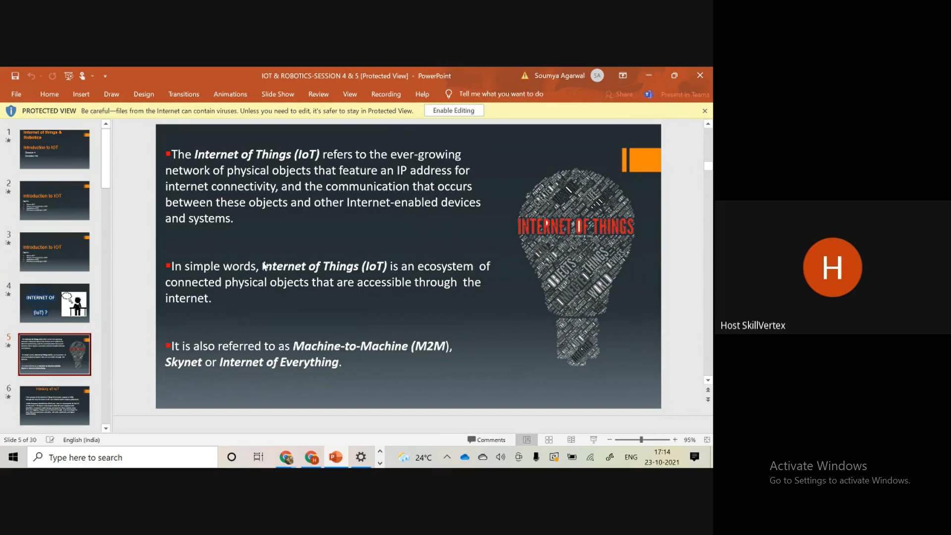

Slide 3
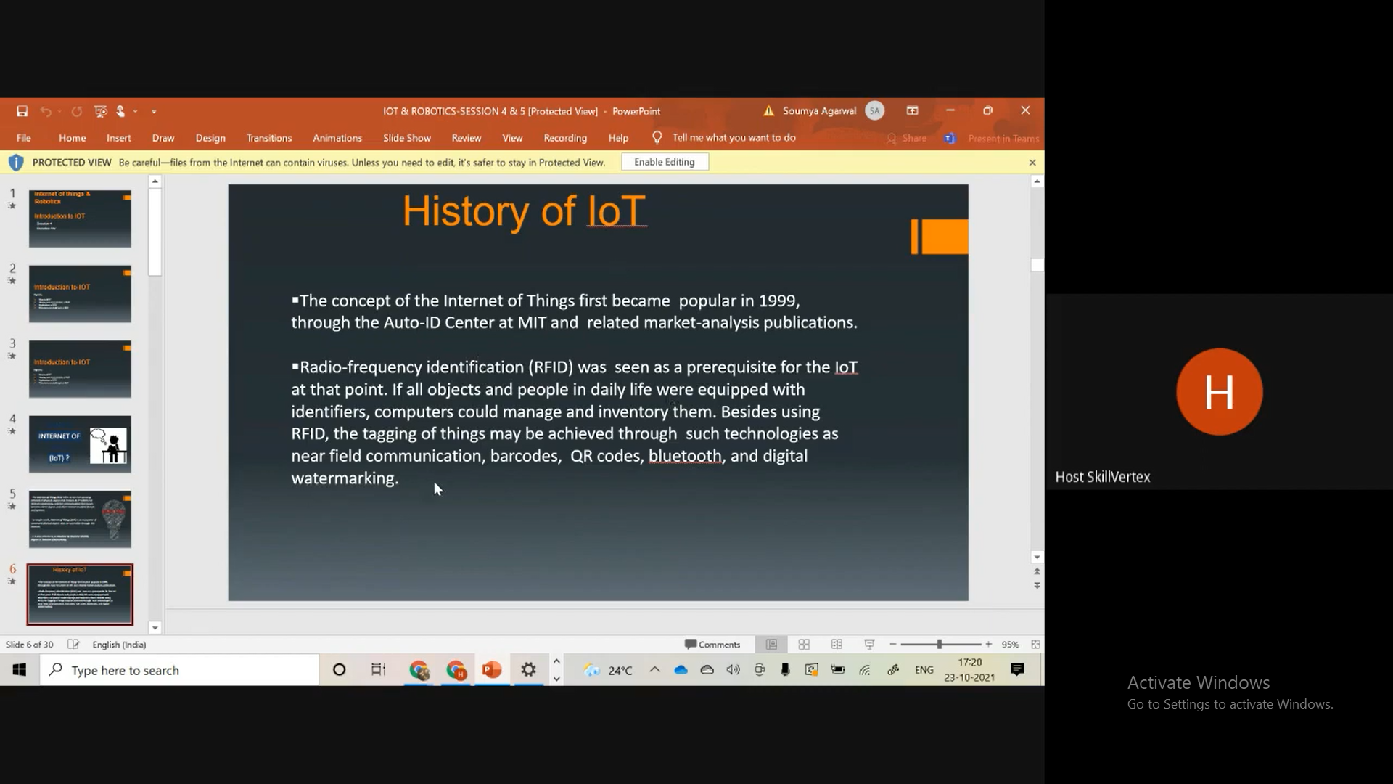

Slide 4
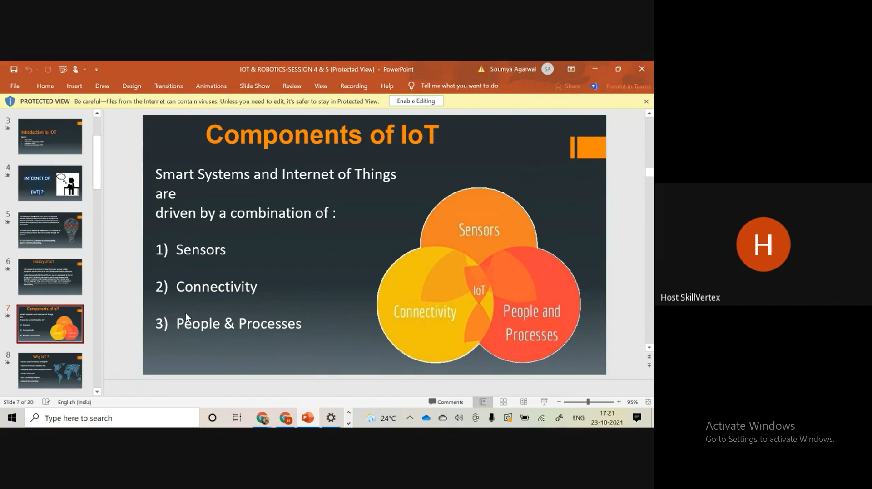

Slide 5
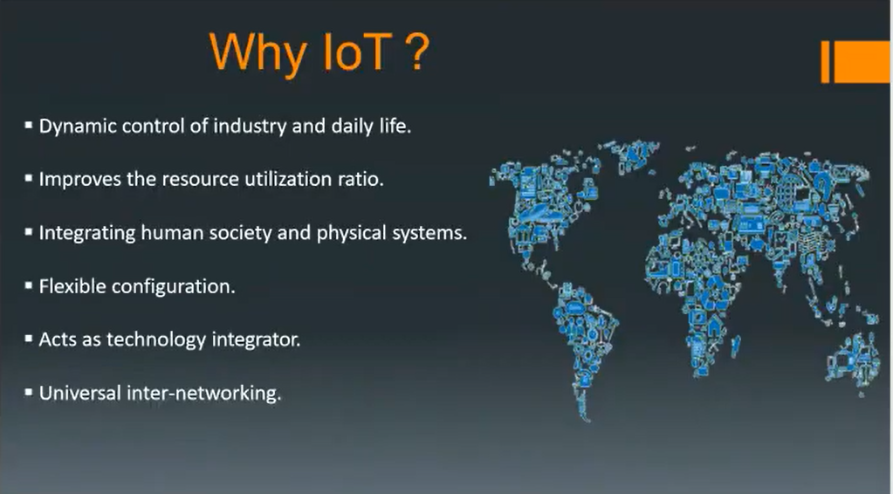

Slide 6
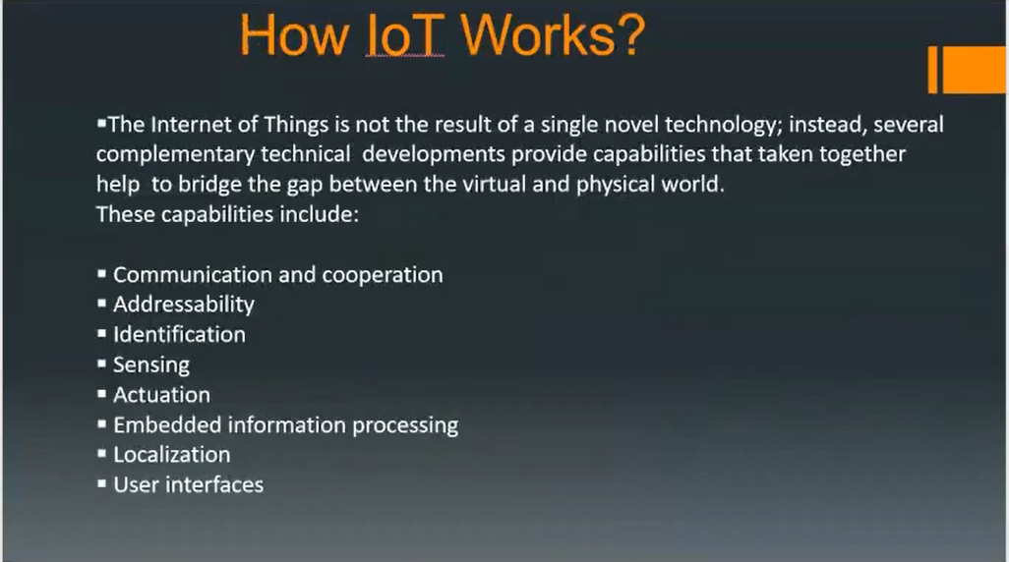

Slide 7
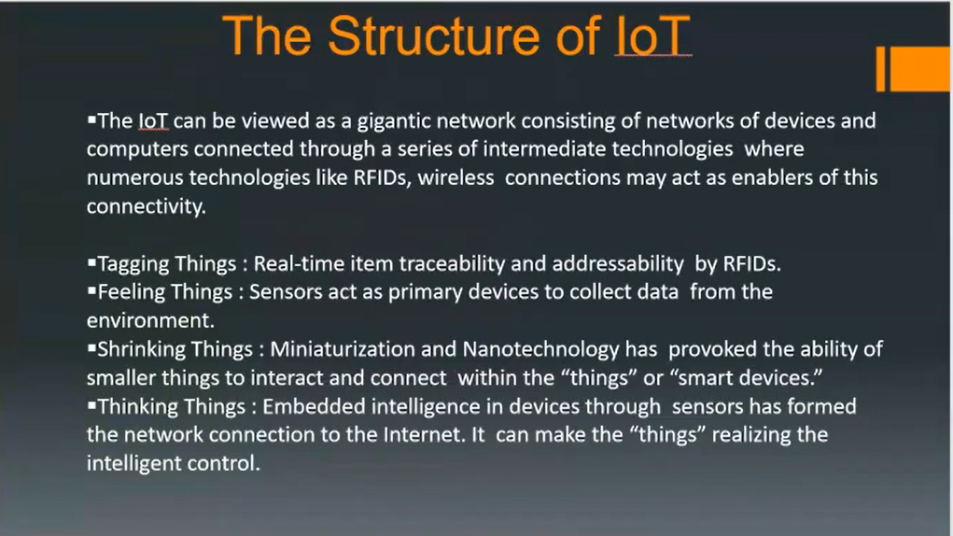

Slide 8
SENSORS
Sensors are designed to respond to specific types of conditions in the physical world, and then generate a signal (usually electrical) that can represent the magnitude of the condition being monitored. Those conditions may be light, heat, sound, distance, pressure, or some other more specific situation
Temperature
ultrasonic
Gas, smoke
Image Sensors
Ir sensors

Slide 9
Temperature sensors
Temperature sensors detect the temperature of the air or a physical object and concert that temperature level into an electrical signal that can be calibrated accurately reflect the measured temperature.
Medical-thermometer, AC, laptops, refrigerator, electric stove
Vehicles
Integrated circuits
IMAGE SENSORS
An image sensor is an electronic device that converts an optical image into an electronic signal. It is used in digital cameras and imaging devices to convert the light received on the camera or imaging device lens into a digital image.
Image sensors are used in electronic imaging devices of both analog and digital types, which include digital cameras, camera modules, camera phones, optical mouse devices, medical imaging equipment, night vision equipment such as thermal imaging devices, radar, sonar, and others.

Slide 10
Ultrasonic SENSORS
Ultrasonic Sensors also known as transceivers when they both send and receive work on a principle similar to radar or sonar which evaluate attributes of a target by interpreting the echoes from radio or sound wavesgas.spectively. Ultrasonic sensors generate high frequency sound waves and evaluate the echo which is received back by the sensor.
Ultrasonic sensors are used primarily as proximity sensors. They can be found in automobile self-parking technology and anti-collision safety systems. Ultrasonic sensors are also used in robotic obstacle detection systems, as well as manufacturing technology.
gas and smoke sensors
When there is a fire a lot of gas particles are produced. The sensor detects these and turns the electricity supply on. It can be used to detect the presence of carbon monoxide gas (CO). ... The sensor detects the gas.
Gas detectors can be used to detect combustible, flammable and toxic gases, and oxygen depletion. This type of device is used widely in industry and can be found in locations, such as on oil rigs, to monitor manufacturing process. They may be used in firefighting.

Slide 11
IR SENSORS
An infrared (IR) sensor is an electronic device that measures and detects infrared radiation in its surrounding environment.
There are two types of infrared sensors: active and passive. Active infrared sensors both emit and detect infrared radiation. Active IR sensors have two parts: a light emitting diode (LED) and a receiver. When an object comes close to the sensor, the infrared light from the LED reflects off of the object and is detected by the receiver.
Passive infrared (PIR) sensors only detect infrared radiation and do not emit it from an LED.

Slide 12
ACUTATORS
An actuator is a device that moves or controls some mechanism. An actuator turns a control signal into mechanical action
ELECTRICAL ACUTATORS : An electric actuator uses electrical energy, is usually actuated by a motor that converts electrical energy into mechanical torque. An example of an electric actuator is a solenoid based electric bell.
Electromechanical
Electrohydraulic actuators

Slide 13
Internet Of Things:
Definition:
A network of Items, Each Embedded With Sensors, Which are connected to the Internet.
ELEMENTS OF IOT:
Most of IOT architectures are built upon core fundamentals.
– Smarter Devices in a different form
– Network and Gateway that allows devices to be part of the IoT
– Middleware that includes data storage spaces and advances predicting capabilities
– End-user applications

Slide 14
IOT Layers
Perception Layer -manages smart devices across the system
Connectivity/Transport Layer -allows transferring data from the cloud to devices and vice-versa, different aspects of gateways and networks.
Processing Layer - controls and manages IoT levels for streamlining data across the system.
Application Layer- aids in the procedures of analytics, device control, and reporting to end-users
Business layer - derives information and decision-making analysis from data.
Security Layer - covers all aspects of protecting the whole IoT architecture
Edge Computing Layer - works at an edge or near the device information collection.

Slide 15
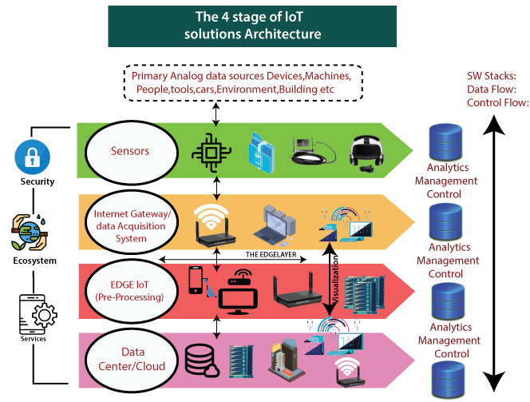

Slide 16
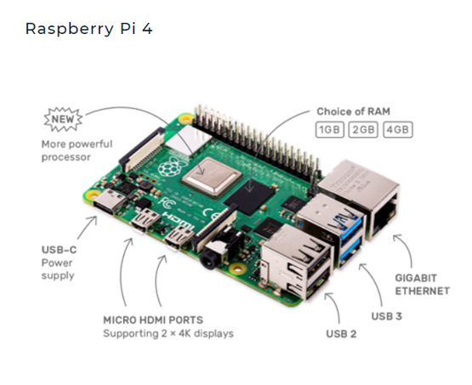
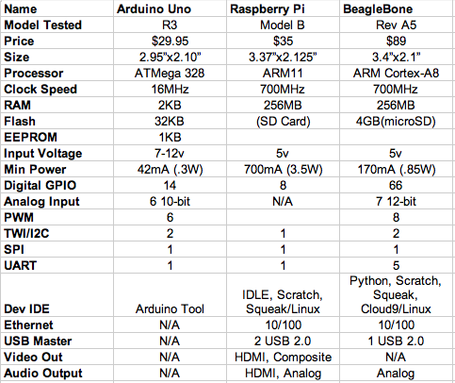
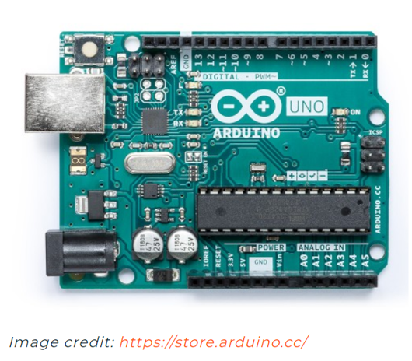
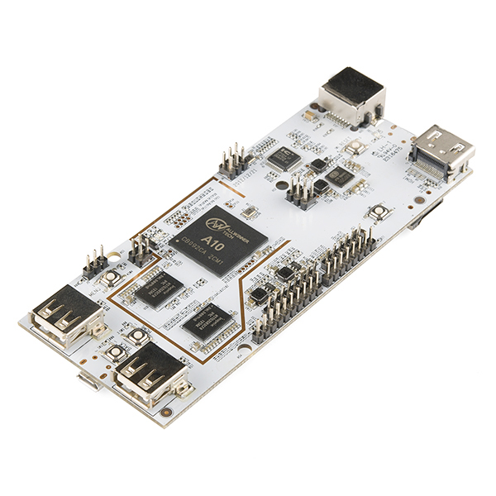
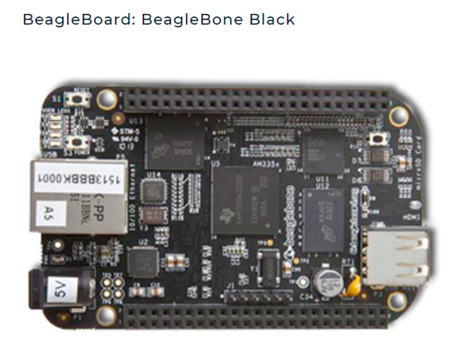
Micro Controllers:

Slide 17
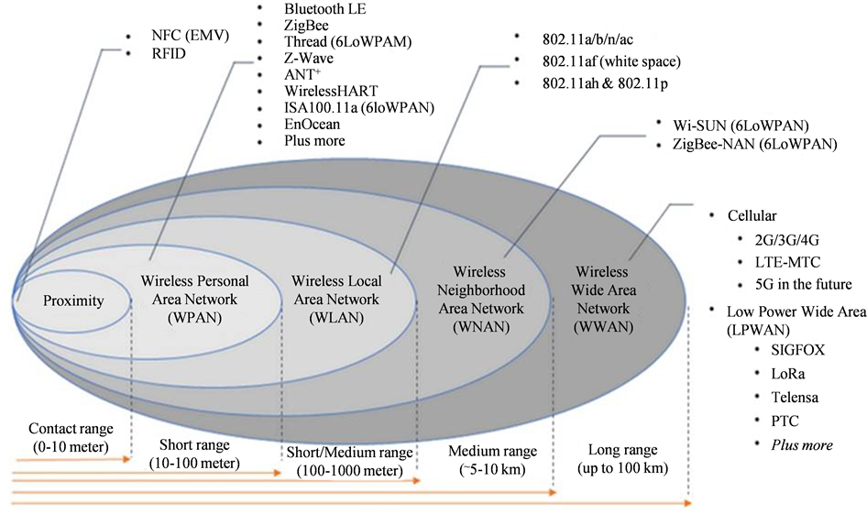
Communication

Slide 18
MIDDLEWARE
DATA CENTER/CLOUD
Application Softwares
APIs
SDKs
Software Frameworks
Applications
Software Security And Privacy
Data Storage – Information Generated by Things
Data Processing
Multiple Access
Data computation
Providers:
AWS
Microsoft
IBM
Salesforce

Slide 19
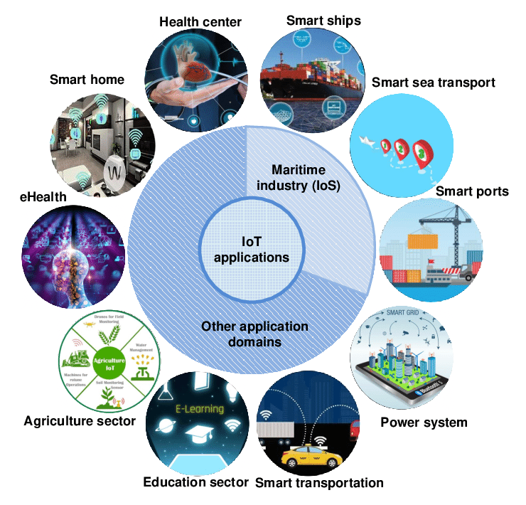

Slide 20
SMART HOME
ANTI - THEFT LOCKING SYSTEM
MONITORING AND CONTROLLING OF HOME APPLIANCES THROUGH INTERNET
SMART CONTROLLING

Slide 21
ANTI THEFT LOCKING SYSTEM
Overall system can be divided into two parts
Locking system
Intimation of theft activities through GSM module
System comprises of locking system, arduino or raspberry pi , GSM module with shield , camera , microphone,speaker.
We use computer vision to detect faces and if face is detected then door will be open
In case of any fraudulent activities the system will alert the house owner with a call or msg and it will sent a message to the police department.

Slide 22
MONITORING AND CONTROLLING OF HOME APPLIANCES THROUGH INTERNET
This system handles two different tasks
Monitoring
Controlling
It comprises of different types of sensors , microcontroller , GSM module with shield and actuators
Room temperature is being calculated by the temperature sensor which comes under monitoring and based on the value received by the user he will give instructions to the actuators through mobile application to switch on fan or ac.
Same example will be satisfied in case of water heater.

Slide 23
SMART CONTROLLING
This system will communicate using bluetooth or wifi only it means it is intended to use inside of home .
This system comprises of bluetooth module , wifi module , camera , speaker , microphone , sensors , actuators and microcontroller.
It is used to control appliances when we are inside the house.
Doors , windows and home appliances power on and power off

Slide 24
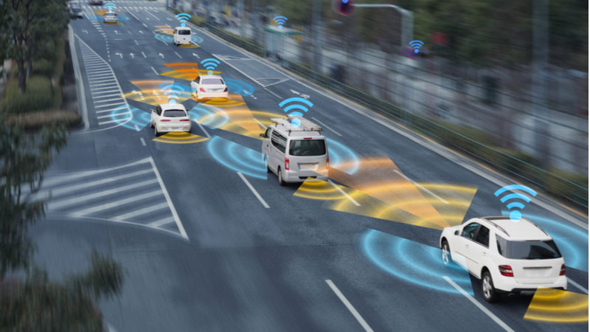
APPLICATIONS OF IOT:
SELF DRIVING CARS

Slide 25
HISTORY
A self driving car is a vehicle that is capable of sensing its environment and navigating without human input. Self driving cars can detect surroundings using a variety of techniques such as radar, GPS and computer vision.
Experiments have been started on automating cars since 1920.
In 1925 an invertor by the name of Francis Houdina show cased the first radio controlled driverless car.
In 1956 a version of GM’S of firebird II was buit with a guidance system or electronic auto control for detector circuits embedded in roadways.
The first self sufficient under truly autonomus car appeared in 1980.
In 1994 the robort cars VaMP and VITA-II by Bundeshwar University drove over 600 miles safely waving through traffic.
In 2009 Google’s self driving project begin and in 2015 Telsa released autopilot software.

Slide 26
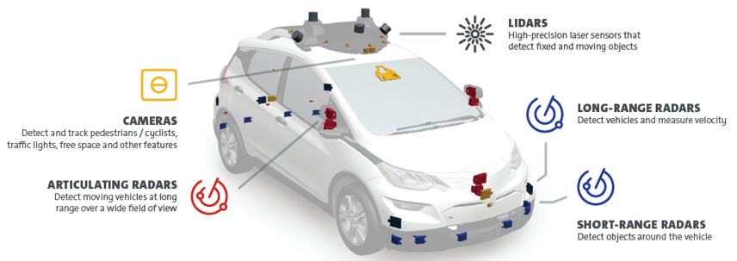
WORKING OF SELF DRIVING CARS

Slide 27
ADVANTAGES
Less prone to accidents
reduction in the need for traffic police
free up people’s time and effort.
accessibility and mobility for those who have difficuilty driving safely.

Slide 28
FUTURE SCOPE
There are many companies working on a driverless car
Uber, Honda, Toyota, Tesla, Hyundai, Volvo, Waymo (partnered with Google, Fiat Chrysler), BMW, Volkswagen, General Motors, and Ford.
The companies that we hear the most about are Tesla, Uber, and Waymo (Google).
it is predicted that by 2040, 95 percent (or 96.3 million) of new vehicles sold will be driverless.

Slide 29
S160043 –Vanaja Malla
S160113 – M.uma anuradha
S160423 – K. LIKHITA
S160774 – gurram venkat rao
S160721 – Banala sravya
S160255 – SNSM sireesha devi
S160659 – CH.jayakumar
S160640 – K Vijaya Harika

